Slide 1
TYPOLOGIE DOMŮ
Nikola Bičišťová

Slide 2
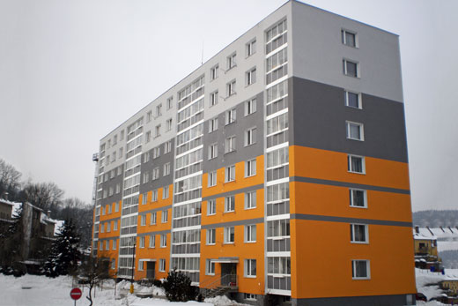
PANELOVÝ DŮM = panelák
Obr.1

Slide 3
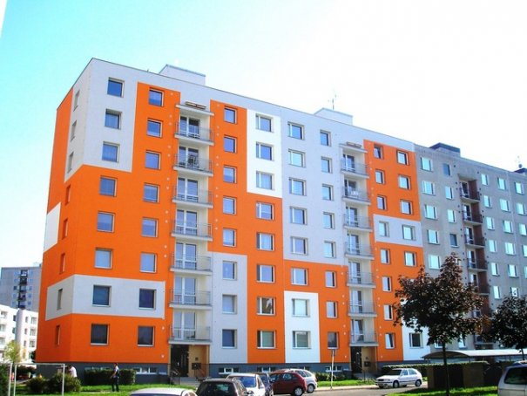
Obr.2

Slide 4
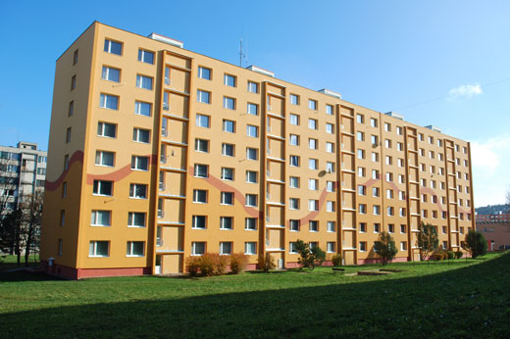
Obr.3

Slide 5
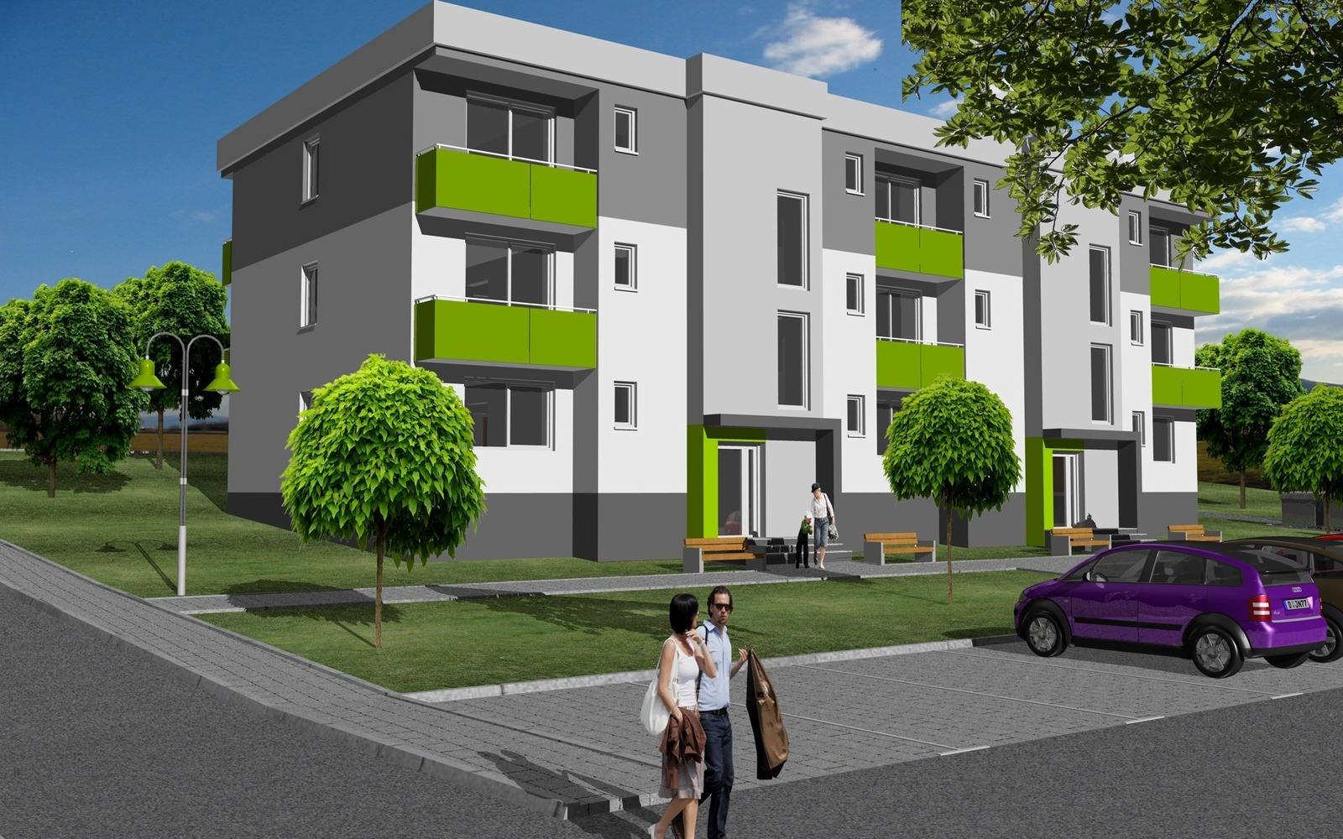
BYTOVKA
Obr.4

Slide 6
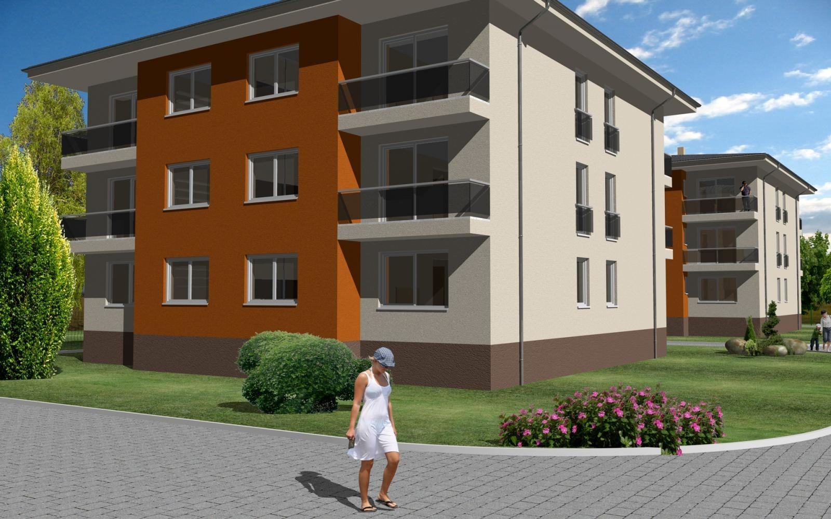
Obr.5

Slide 7
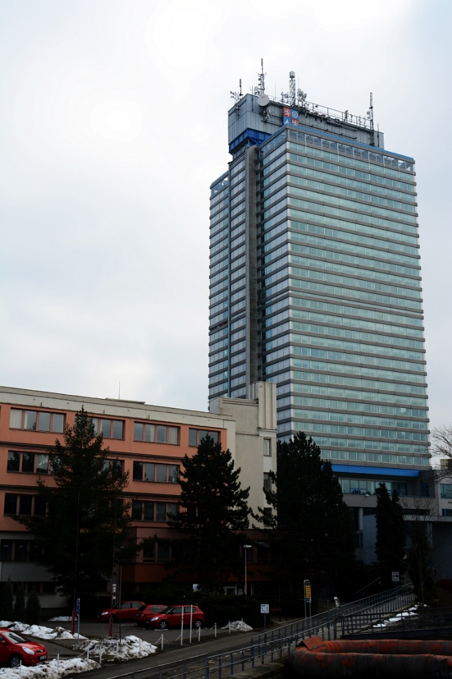
Mrakodrap
Obr.6
Krajský úřad Libereckého kraje v Liberci (78 m)

Slide 8
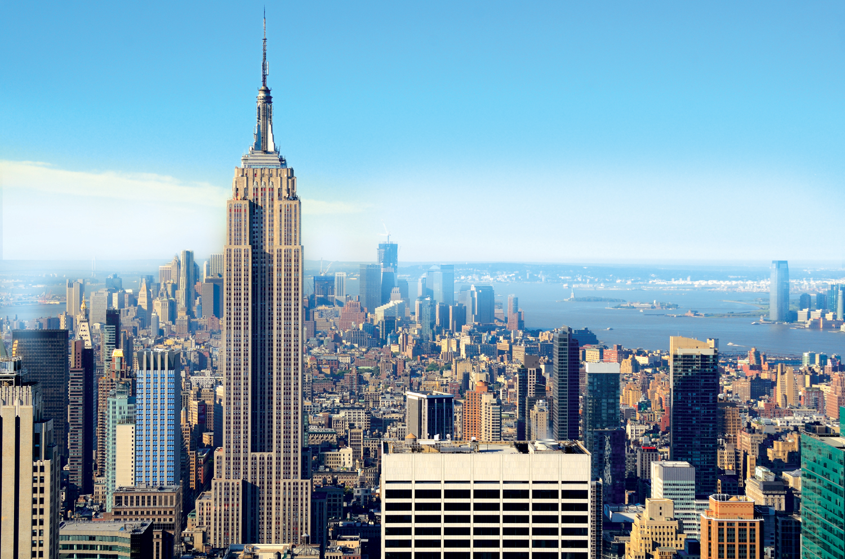
Obr.7
Empire State Building

Slide 9
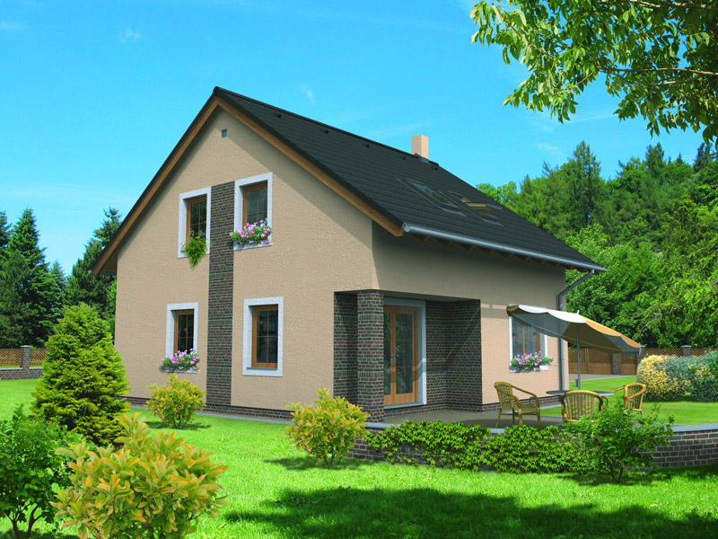
RODINNÝ DŮM
Obr.8

Slide 10
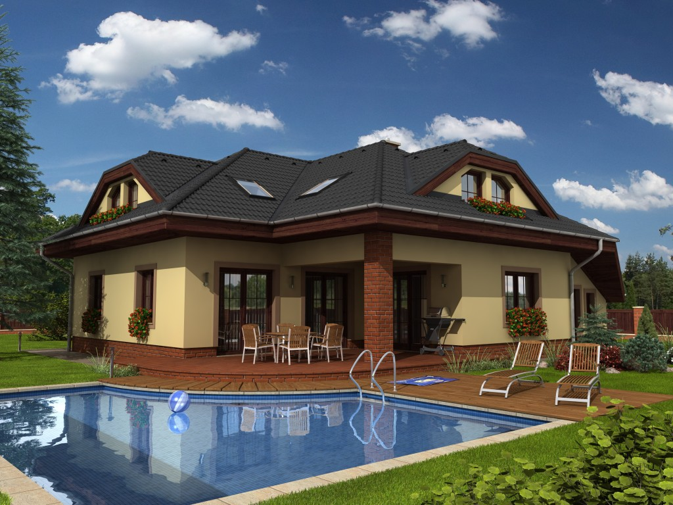
Obr.9

Slide 11
Zdroje obrázků
Obr.1 https://www.google.cz/search?q=panelový+dům&client=opera&hs=Bkg&tbm=isch&tbo=u&source=univ&sa=X&ved=0ahUKEwiQrdTO_YbMAhUILZoKHZf5DjIQsAQIJg&biw=1366&bih=658#tbm=isch&tbs=rimg%3ACWP6y647W29vIjjleWMDTnIDJqItQQ9xJtwIoeDxmnZAWTka6xAF0Ir1HlyHhethK6P-XW7YJC2EAPs5UaZa7Fi1VioSCeV5YwNOcgMmEYKQ2VQ0i1drKhIJoi1BD3Em3AgRcE48hBGohnYqEgmh4PGadkBZORHmT2jm8vO5ySoSCRrrEAXQivUeEfiNNH2sXKjKKhIJXIeF62Ero_14R83NPITDx_1zMqEgldbtgkLYQA-xFfUuIYh80AQioSCTlRplrsWLVWEW7eaxdivFg7&q=panel%C3%A1k&imgdii=WuSHn-R038PnzM%3A%3BWuSHn-R038PnzM%3A%3B-GHGZ8wW8wUAFM%3A&imgrc=WuSHn-R038PnzM%3A
Obr.2 https://www.google.cz/search?q=panelový+dům&client=opera&hs=Bkg&tbm=isch&tbo=u&source=univ&sa=X&ved=0ahUKEwiQrdTO_YbMAhUILZoKHZf5DjIQsAQIJg&biw=1366&bih=658#tbm=isch&q=panel%C3%A1k&imgdii=biUY5dwHpAsPzM%3A%3BbiUY5dwHpAsPzM%3A%3BSfOF6fits1OG5M%3A&imgrc=biUY5dwHpAsPzM%3A
Obr.3 https://www.google.cz/search?q=panelový+dům&client=opera&hs=Bkg&tbm=isch&tbo=u&source=univ&sa=X&ved=0ahUKEwiQrdTO_YbMAhUILZoKHZf5DjIQsAQIJg&biw=1366&bih=658#imgrc=y-qNpYuX6GEkuM%3A
Obr.4 https://www.google.cz/search?q=bytovka&client=opera&hs=Vjg&tbm=isch&tbo=u&source=univ&sa=X&ved=0ahUKEwjhluS6_YbMAhXEJ5oKHUCFBjMQsAQILQ&biw=1366&bih=658#imgdii=RQGfbNi2D2cMvM%3A%3BRQGfbNi2D2cMvM%3A%3BNEoc58y2swBWGM%3A&imgrc=RQGfbNi2D2cMvM%3A
Obr.5 https://www.google.cz/search?q=bytovka&client=opera&hs=Vjg&tbm=isch&tbo=u&source=univ&sa=X&ved=0ahUKEwjhluS6_YbMAhXEJ5oKHUCFBjMQsAQILQ&biw=1366&bih=658&dpr=1#tbm=isch&tbs=rimg%3ACUUBn2zYtg9nIjh4-PFjgYA_18zRKHOfMtrMA0Olo7LtPLUJHHQh5i3OrfuRZ539NkT_11EQzqPj-9af8qedjSbjJDFioSCXj48WOBgD_1zEZpjfJ_1MimvfKhIJNEoc58y2swARnpW0PasW8xcqEgnQ6Wjsu08tQhF6cKUPIwWHlyoSCUcdCHmLc6t-Ebqcr_1SEtEJBKhIJ5Fnnf02RP_1URrB9ksNXXPAcqEgkRDOo-P71p_1xHte1wwIEbbHioSCSp52NJuMkMWEVb984zGFPOr&q=bytovka&imgrc=RQGfbNi2D2cMvM%3A
Obr.6 https://cs.wikipedia.org/wiki/Seznam_nejvyšších_budov_v_Česku#/media/File:LibKraj.jpg
Obr.7 https://www.google.cz/search?q=mrakodrap&client=opera&hs=8tg&tbm=isch&tbo=u&source=univ&sa=X&ved=0ahUKEwjln4D1_4bMAhUoYZoKHeTjCkUQsAQIKw&biw=1366&bih=658&dpr=1#tbm=isch&q=empire+state+building&imgrc=m9BroEW0YgXWwM%3A
Obr.8 https://www.google.cz/search?q=rodinný+dům&client=opera&hs=w0g&tbm=isch&tbo=u&source=univ&sa=X&ved=0ahUKEwjp1Ym-gYfMAhWFNJoKHcjFDkIQsAQIJg&biw=1366&bih=658#imgdii=q77AaKF3_240zM%3A%3Bq77AaKF3_240zM%3A%3B2l5ShFu95ds3vM%3A&imgrc=q77AaKF3_240zM%3A
Obr.9 https://www.google.cz/search?q=rodinný+dům&client=opera&hs=w0g&tbm=isch&tbo=u&source=univ&sa=X&ved=0ahUKEwjp1Ym-gYfMAhWFNJoKHcjFDkIQsAQIJg&biw=1366&bih=658#imgdii=XibtsYPjuU6IOM%3A%3BXibtsYPjuU6IOM%3A%3B0CSwB1emSMZ-QM%3A&imgrc=XibtsYPjuU6IOM%3A

